Slide 1
Extraction of User-Defined Information from PDF
Department of Computer Sciences, Bahria University Lahore Campus, Lahore, Pakistan:
Rohaan Nadeem, Noor Fatima, Tahir Iqbal
Gulab Devi Educational Complex, Lahore,Pakistan:
Junaid Altaf
School of Biochemistry and Biotechnology, University of the Punjab, Lahore, Pakistan:
Asma Irshad
Department of Computer Sciences, University of Central Punjab, Lahore, Pakistan:
Asif Farooq

Slide 2
Introduction
Background
The project aims to develop a tool that automates user-defined text extraction from PDFs, streamlining data retrieval for text-heavy sectors like finance, healthcare, and education.
Problem Statement
Lack of tools for user-defined, and scalable PDF text extraction.
Relevance
Provides a robust solution for researchers, analysts, and professionals working with textual data.

Slide 3
Objectives
Main Goal
Develop a tool for efficient extraction of user-defined textual data from PDFs.
Provide a user-friendly interface for customizable search and output.
Specific Questions
How to scale the input prompt?
How to enhance the response and provide multiple type of response?

Slide 4
Related Work
Existing Tools
Focus on general data extraction but face issues such as input character limits for search parameters.
Key Deficiencies
Poor contextual understanding
Lack of user-friendly interfaces
Innovation
Combines PyMuPDF and LLM for high-accuracy text-based extraction and providing meta analyses.

Slide 5
Methodology
Overview of the approach or framework used
Utilizes PyMuPDF for text extraction and LLMs for semantic analysis.
Tools, techniques, or methods applied
Customizable search parameters for tailored data retrieval.
Assumptions
Focus on PDFs only.
Does not handle graphical or complex layouts.

Slide 6
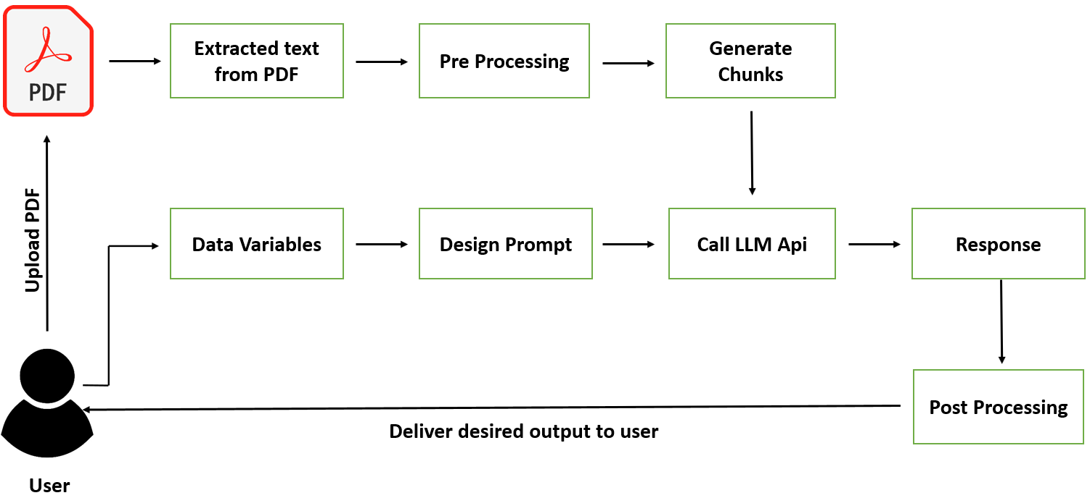
Proposed Model/Design
User uploads PDFs.
Defines search parameters.
Extracted data presented in text or graphical formats.
Diagram

Slide 7
Experimental Setup
Dataset
Text-based PDFs of varying lengths and complexities.
Parameters, configurations, or tools
PyMuPDF for PDF text extraction.
LLMs for semantic analysis.
MERN stack for frontend and backend integration.
Experimental conditions
Focused exclusively on text-heavy PDFs.

Slide 8
Results
Findings
Streamlined the extraction process for diverse professional use cases.
Achieved extraction of user-defined information from PDFs in both textual and graphical format too.
Highlight significant results
Enhanced productivity by automating manual extraction tasks.

Slide 9
Discussion
Interpretation
PyMuPDF ensures text-based precision.
LLM adds contextual understanding.
Strengths
Tailored for professionals across domains.
Limitations
Does not process graphical elements or non-textual content.

Slide 10
Conclusion
Summary
A streamlined tool for efficient and user-friendly PDF text extraction.
Takeaways
Automates data retrieval.
Supports tailored user needs.
Implications
Incorporate advanced parsing and batch processing capabilities and reference of the context from where the response is given

Slide 11
Future Work
Possible extensions or next steps
Integrating advanced OCR for graphical data.
Batch processing capabilities for large-scale applications.
Improved semantic analysis for unstructured text.
Improved user interface for a seamless experience.
Challenges or open problems to address
Handling complex layouts and non-textual elements.

Slide 12
Acknowledgements
Institutions
Bahria University Lahore Campus, Gulab Devi Educational Complex, University of the Punjab, University of Central Punjab.
Collaborators
Thanks to faculty and team members for their contributions.

